Slide 1
Oracle Database 10g szoftver telepítése

Slide 2
Célok
A lecke elvégzése után ön képes lesz az alábbiakra:
  Rendszerkövetelmények azonosítása
  Az Optimális Rugalmas Architektúra használata
  Szoftvertelepítés az Oracle Univerzális Telepítővel
Notes:
Oracle Database 10g: Administration Workshop I 2-<number>

Slide 3


Rendszerkövetelmények
Harver:
  512 MB fizikai memória (RAM)
  1 GB cseretárhely (RAM méretének kétszerese)
  400 MB lemezterület az ideiglenes könyvtárban (/tmp vagy \Temp)
  1.5 GB lemezterület az Oracle szoftvereknek
  1.5 GB lemezterület az előre konfigurált adatbázisnak
Operációs rendszer: nézzen utána a dokumentációban
Notes:
Oracle Database 10g: Administration Workshop I 2-<number>
System Requirements
The hardware requirements listed in the slide are minimal requirements across all platforms. Your installation may require more, especially disk space. Also, as a general rule, the more RAM you have available the better.
Note: On systems with 2 GB or more of RAM, the swap space can be between one and two times the size of RAM.
Because each operating system has different requirements, you must refer to the operating system–specific Oracle documentation for information about operating system requirements. These will list the releases of the operating system that are supported, along with how to set up any operating system groups or users, and other steps that are needed for the installation.
For this course all the necessary operating system requirement steps have been completed.

Slide 4


Optimális Rugalmas Architektúra (OFA)
Az OFA arra lett tervezve, hogy:
  Nagy mennyiségű szoftvert kezeljen
  Megkönnyítse a rendszeres adminisztrációs feladatokat
  Megkönnyítse több Oracle adatbázis közötti váltást
  Alkalmasan kezelje és adminisztrálja az adatbázis növekedését
  Segítsen megszüntetni a szabad terület töredezését
Notes:
Oracle Database 10g: Administration Workshop I 2-<number>
Optimal Flexible Architecture (OFA)
OFA is a method for configuring the Oracle database and other databases. OFA takes advantage of the OS and disk subsystems capabilities to create an easy-to-administer configuration that allows maximum flexibility for growing and high-performance databases. The methods described here are the basics of OFA.
OFA is designed to:
Organize large amounts of complicated software and data on disk, to avoid device bottlenecks and poor performance
Facilitate routine administrative tasks such as software and data backup, which are often vulnerable to data corruption
Facilitate switching between multiple Oracle databases
Adequately manage and administer database growth
Help eliminate fragmentation of free space in the data dictionary, isolate other fragmentation, and minimize resource contention
For details on the goals and implementation of OFA, refer to Oracle Installation Guide for UNIX Systems, Appendix D.

Slide 5



Az Optimális Rugalmas Architektúra használata
Bekötési pontok elnevezése:
  /u01
  /disk01
Könyvtárak elnevezése:
  /u01/app/oracle
  /u01/app/applmgr
Fájlok elnevezése:
  Vezérlő fájlok: controln.ctl
  Helyreállítási naplók: redon.log
  Adatfájlok: tn.dbf
Notes:
Oracle Database 10g: Administration Workshop I 2-<number>
Using Optimal Flexible Architecture
At the core of OFA is a naming scheme, which gives you a standard to apply to your mount points (which are often the physical disks), directories and subdirectories on those mount points, and finally the files themselves.
Mount point syntax: Name all mount points using the syntax /pm, where p is a string constant and m is a unique fixed-length key (typically a two-digit number) used to distinguish each mount point. Example mount points are /u01, and /u02.
Home directories syntax: Name all home directories using the syntax /pm/h/u. Where pm is a mount point name, h is a standard directory name and u is the name of the owner of the directory. Examples of OFA-compliant home directories are:
/u01/app/oracle
/u01/home/oracle
Software directories syntax: To help fulfill the OFA feature of simultaneously executing multiple versions of application software, store each version of the Oracle software in a directory matching the pattern /pm/h/u/product/v. Here product is a literal and the variable v is used for the version number. So an OFA-compliant installation of the Oracle Database 10g version 10.1.0 would look like:
/u01/app/oracle/product/10.1.0

Slide 6
Az Optimális Rugalmas Architektúra használata
Teljes jegyzetlap
Notes:
Oracle Database 10g: Administration Workshop I 2-<number>
Using Optimal Flexible Architecture (continued)
Naming subdirectories syntax: To facilitate the organization of administrative data, you should store database-specific administration files in subdirectories matching the pattern /h/admin/d/a/, where h is the Oracle software owner’s home directory, admin is a literal, d is the database name, and a is a subdirectory for each of the database administration files. Following is a list of these administration file subdirectories:
adhoc: Ad hoc SQL scripts for a particular database
arch: Archived redo log files
adump : Audit files (Set the AUDIT_FILE_DEST initialization parameter to the adump directory. Clean out this subdirectory periodically.)
Bdump: Background process trace files
Cdump: Core dump files
Create: Programs used to create the database
Exp: Database export files
Logbook: Files recording the status and history of the database
Pfile: Instance parameter files
udump: User SQL trace files
File-naming syntax: The following naming convention for database files ensures that they are easily identifiable:
Control files: /pm/q/d/control.ctl
Redo log files: /pm/q/d/redon.log
Data files: /pm/q/d/tn.dbf
The variables used in these file names are:
Pm: A mount point name as described previously
q: A string distinguishing Oracle data from all other files (commonly named ORACLE or oradata)
d: The value of the initialization parameter DB_NAME (the database name)
t: An Oracle tablespace name
n: A two-digit string
Note: Do not store files other than control files, redo log files, or data files associated with database d in the path /pm/q/d/.

Slide 7

Környezeti változók beállítása
  ORACLE_BASE: Az OFA Oracle-könyvtárszerkezetének kezdőpontja
  ORACLE_HOME: Az Oracle szoftvereket tartalmazó könyvtár
  ORACLE_SID: A kezdeti példánynév (alapértelmezett: ORCL)
  NLS_LANG: A nyelv, terület és a kliens karakterkészletének beállítása
Notes:
Oracle Database 10g: Administration Workshop I 2-<number>
Setting Environment Variables
There are many Oracle environment variables, and the ones mentioned here are very important to a successful installation and use of an Oracle database. None of these are required to be set, but by setting them prior to the installation you may avoid future problems.
ORACLE_BASE: Specifies the base of the Oracle directory structure for OFA. Use of this is optional, but if used this can facilitate future installations and upgrades. It is a directory path for example:
/u01/app/oracle
ORACLE_HOME: Specifies the directory containing the Oracle software. It is a directory path, for example:
$ORACLE_BASE/product/10.1.0
ORACLE_SID: The initial instance name (ORCL by default). It is a string of numbers and letters that must begin with a letter. Oracle Corporation suggests that a maximum of eight characters be used for system identifiers.

Slide 8
Környezeti változók beállítása
Teljes jegyzetlap
Notes:
Oracle Database 10g: Administration Workshop I 2-<number>
Setting Environment Variables (continued)
NLS_LANG: Specifies the initial NLS settings for a session on the form language_territory.character set. For example, a setting of:
AMERICAN_DENMARK.WE8MSWIN1252
This sets the session to use the language AMERICAN for Oracle messages, sorting, day names, and month names. The territory is DENMARK, which sets the time format, date format, and numeric and monetary conventions. The character set of WE8MSWIN1252 instructs Oracle Net to convert character information to this character set. This is an environment variable in UNIX and a registry setting in Windows. You can query the actual NLS settings of your current session by:
select * from nls_session_parameters;
Refer to the Globalization Support Guide for valid languages, territories, character sets, and more information about language support.
Note: A Windows installation defaults the NLS_LANG values in the registry where the language part originates from the keyboard language. This has the effect that default installation on Windows with non-American keyboards will get the non-American value in the NLS_LANG setting. This in turn will default the NLS_SORT session variable to be different from “binary,” which makes it difficult for the optimizer to use character-based indexes for sessions from this node.

Slide 9
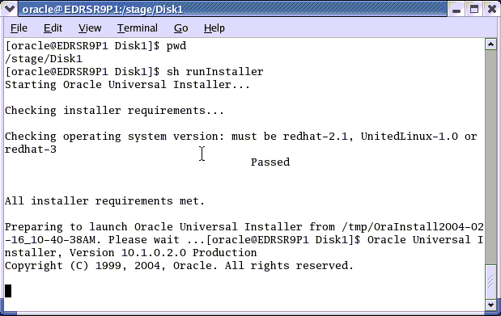
Telepítés előtti ellenőrzések
Notes:
Oracle Database 10g: Administration Workshop I 2-<number>
Preinstallation Checks
Before the Oracle Universal Installer GUI interface is launched, there are a number of checks that are performed to verify that minimal requirements are met. In the event that your system doesn’t meet one or more of the requirements, you can choose to continue the installation by using the –ignoreSysPrereqs flag when running the installer. However, the likelihood of a successful installation is greatly reduced if the requirements are not met. For example:
$ sh runInstaller –ignoreSysPrereqs
Note: You can use the –help flag to see more options for the Oracle Universal Installer.

Slide 10

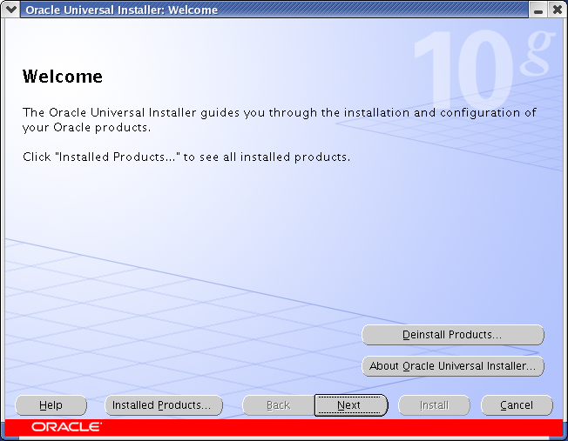
Oracle Univerzális Telepítő
Notes:
Oracle Database 10g: Administration Workshop I 2-<number>
Oracle Universal Installer
Oracle Universal Installer is a Java application that performs component-based installations and enables different levels of integrated bundle, suite, and Web-based installations, as well as complex logic in a single package. The installation engine is easily portable across all Java-enabled platforms, and platform-specific issues can be encapsulated from the overall installation process. The Oracle Universal Installer provides the following capabilities for addressing software management and distribution:
Automatic dependency resolution and complex logic handling
Installation from the Web
Component and suite installations
Implicit deinstallation
Support for multiple Oracle homes
National language support (NLS)/globalization support
Support for distributed installations
Unattended “silent” installations using response files

Slide 11
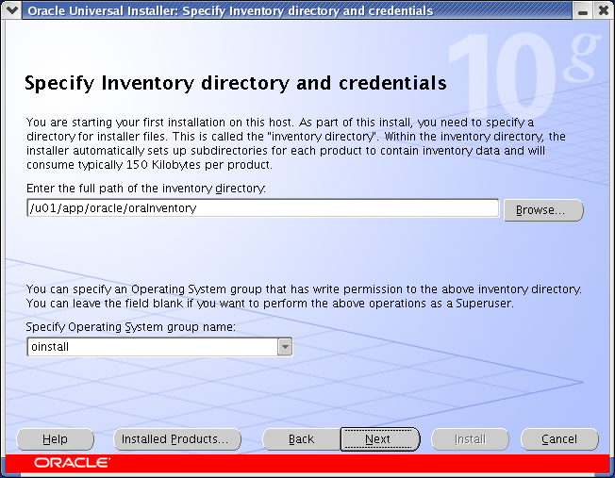
Leltár és UNIX csoportnév
Notes:
Oracle Database 10g: Administration Workshop I 2-<number>
Inventory and UNIX Group Name
The inventory directory is an area that is used during the installation of the software. The files in this directory should not be deleted. The Oracle Universal Installer inventory is the location for the Oracle Universal Installer’s bookkeeping. The inventory stores information about:
All Oracle software products installed in all Oracle homes on a machine
Other non-Oracle products included with Oracle software, such as the Java Runtime Environment (JRE)
You should expect these files to take up about 4 MB of space.
If you are installing a product on a UNIX system, the Installer will also prompt you to provide the name of the group that should own the base directory. You must choose a UNIX group name that will have permissions to update, install, and deinstall Oracle software. Members of this group must have write permissions to the base directory that is chosen. Only users who belong to this group are able to install or deinstall software on this machine.

Slide 12
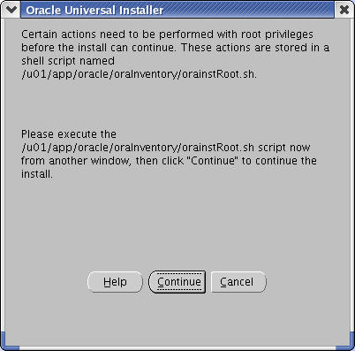
orainstRoot.sh
# sh /u01/app/oracle/oraInventory/orainstRoot.sh
Creating the Oracle inventory pointer file (/etc/oraInst.loc)
Changing groupname of /u01/app/oracle/oraInventory to oinstall.
Notes:
Oracle Database 10g: Administration Workshop I 2-<number>
orainstRoot.sh
When installing on a UNIX platform, you must run the orainstRoot.sh script as root. This script creates the inventory pointer file (on Linux this file is /etc/oraInst.loc). The inventory pointer file is used by the Oracle Universal Installer at start up to find the inventory location. An example of the file is:
inventory_loc=/oracle/oraInventory
inst_group=oinstall
With a Microsoft Windows installation the inventory location is contained within the registry.

Slide 13
orainstRoot.sh
Teljes jegyzetlap
Notes:
Oracle Database 10g: Administration Workshop I 2-<number>
orainstRoot.sh (continued)
The oraintRoot.sh script looks like the following:
#!/bin/sh
INVPTR=/etc/oraInst.loc
INVLOC=/oracle/oraInventory
GRP=oinstall
PTRDIR="`dirname $INVPTR`";
# Create the software inventory location pointer file
if [ ! -d "$PTRDIR" ]; then
mkdir -p $PTRDIR;
fi
echo "Creating the Oracle inventory pointer file ($INVPTR)";
echo inventory_loc=$INVLOC > $INVPTR
echo inst_group=$GRP >> $INVPTR
chmod 644 $INVPTR
# Create the inventory directory if it doesn't exist
if [ ! -d "$INVLOC" ];then
echo "Creating the Oracle inventory directory ($INVLOC)";
mkdir -p $INVLOC;
chmod 775 $INVLOC;
fi
echo "Changing groupname of $INVLOC to oinstall.";
chgrp oinstall $INVLOC;
if [ $? != 0 ]; then
echo "WARNING: chgrp of $INVLOC to oinstall failed!";
fi

Slide 14
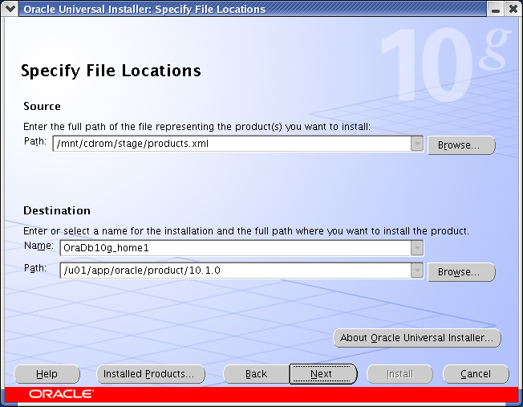
Fájlok helye
Notes:
Oracle Database 10g: Administration Workshop I 2-<number>
File Locations
The Universal Installer provides a default value on the Specify File Locations page that points to the location of the product’s installation kit or stage.
Oracle homes are identified by name. The Oracle home name identifies the program group associated with a particular Oracle home and the Oracle services installed on the associated home. The Oracle home name must be 1 to 16 characters long and can include only alphanumeric characters and underscores, and must not include spaces.
Oracle Universal Installer maintains the following Oracle homes on Windows platforms:
All Oracle homes that are already created using the Oracle Universal Installer
All homes created using the previous Oracle Universal Installer (ORCA-based)
The home saved in the ORACLE_HOME registry entry.
Oracle Universal Installer maintains the following Oracle homes on UNIX:
All Oracle homes that are already created using the Oracle Universal Installer
All homes as defined in the /var/opt/oratab file (In Linux, /etc/oratab)
The home saved in the ORACLE_HOME environment variable
If none of these homes exists, a default home is calculated based on the disk volume with the largest amount of free space.

Slide 15
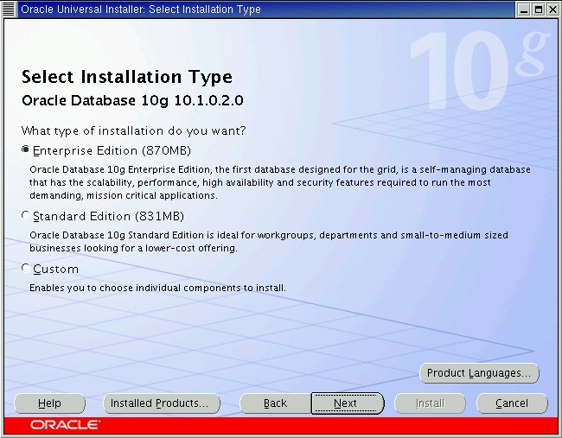
Telepítés típusa
Notes:
Oracle Database 10g: Administration Workshop I 2-<number>
Install Type
Oracle Database Enterprise Edition offers industry-leading scalability and reliability in both clustered and single system configurations. It provides the most comprehensive features for online transaction processing and business intelligence.
Oracle Standard Edition is for small and medium business, or departmental applications that demand all the power, reliability, and security of Oracle without all the Enterprise options.
The following enterprise-level features are some of the options not available with the Oracle Standard Edition:
Oracle Data Guard: A comprehensive set of services that create, manage, and monitor one or more standby databases.
Oracle Advanced Security, Oracle Label Security, Enterprise User Security, Virtual Private Database, N-tier authentication, and Fine Grained Auditing: These options extend the security features of the Oracle Database 10g.
Oracle Partitioning, Oracle OLAP, Export Transportable Tablespace, and other features that support Enterprise Data Warehouses.
The custom install allows you to pick individual components to install.

Slide 16
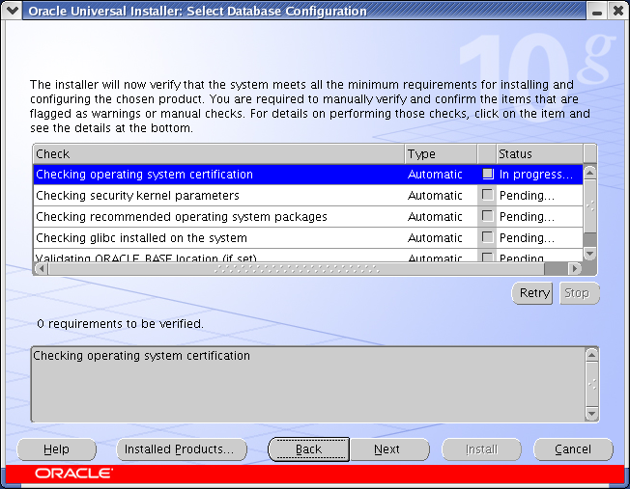
Előfeltételek ellenőrzése
Notes:
Oracle Database 10g: Administration Workshop I 2-<number>
Prerequisite Checks
Before installation, the Oracle Universal Installer checks the environment for requirements necessary for a successful installation. This page show the name, type and status for all prerequisite checks. Automatic checks are run first, if there are optional checks you can run them once the automatic checks are compete.
Once all checks are complete, there will be a summary of the checks done on the lower part of the page. A check may require verification if a warning was produced during the execution or a manual check was not confirmed. To verify a warning or manual check, click the check box for the check that produced a warning or is a manual check.

Slide 17
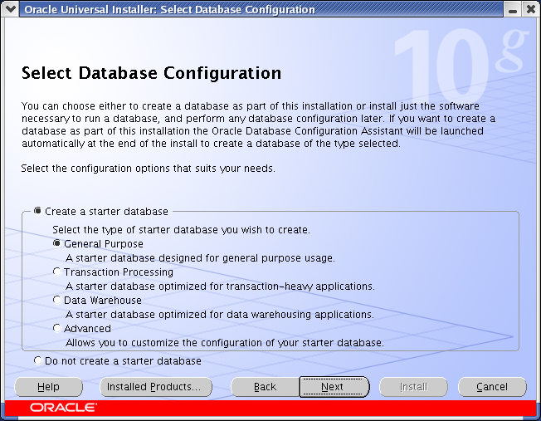
Induló adatbázis
Notes:
Oracle Database 10g: Administration Workshop I 2-<number>
Starter Database
There are three template database from which you can choose, or you can set up a custom starter database. The template databases use pre configured files and create a database quickly, although with these you can customize the database. The advanced option allows you total flexibility in the creation of the started database, but does take longer to build.
Note: If you choose not to create a starter database, the summary page appears next.

Slide 18
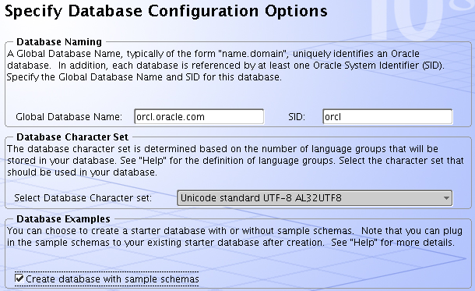
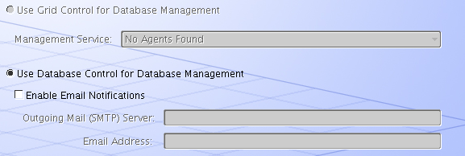
Konfiguráció és kezelés
Notes:
Oracle Database 10g: Administration Workshop I 2-<number>
Configuration and Management
If you select to create a starter database as part of your install, you will go through a series of pages asking you for information to configure the starter database.
Database Naming: Here you name the database; the default is orcl.
Database Character Set: This is the character set used in the database to store your data. You should take some time to determine what is the base character set for your data. Although it is possible to change a character set later, it can be a very time-consuming task, and will require some down time for your database. If unsure about which character set to use and you know you will be using multiple languages, the Unicode Standard UFT-8 AL32UTF8 is a good choice. The WE8ISO8859P1 character set doesn’t have support for the euro symbol (€) , but WE8ISO8859P15 does. For more details on selecting the appropriate character set, see the Oracle Database Globalization Support Guide.
Sample Schemas: The sample schemas are a set of schemas used for demonstrations and training.
Database Management: Grid control is used to manage many databases either on one machine or several machines. Database control is used to manage a single database.

Slide 19
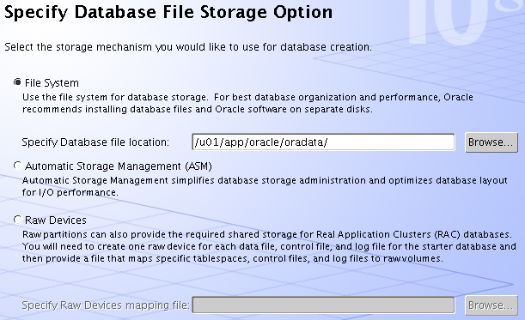
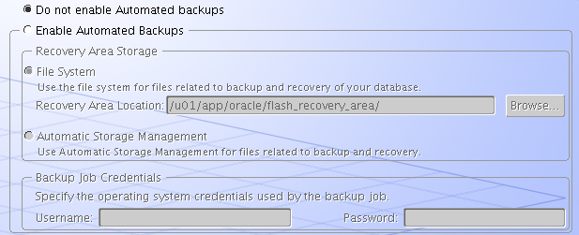
Fájltárolás és biztonsági mentés
Notes:
Oracle Database 10g: Administration Workshop I 2-<number>
File Storage and Backup Recovery
File storage options:
File System: This specifies where to store files in your OS configured file system.
Automatic Storage Management (ASM): Automatic Storage Management files are created and managed automatically, and you get the additional benefits of features such as mirroring and striping. For details on how to set up ASM, see the Oracle Database Administrator’s Guide.
Raw Devices (Partitions): These are disk partitions without a file system on them. Generally you should use these only if you are very familiar with the use of raw partitions already. Check your OS documentation for details on setting up and maintaining raw partitions.
Backup and Recovery Options:
Do not enable Automated backups: Eventually you will need to set up a backup plan. If you select not to set it up now you can do so later.
Enable Automated Backups: When you enable Automated Backups, you need to specify where the backups will be stored, and information about the backup job used for the backups.

Slide 20
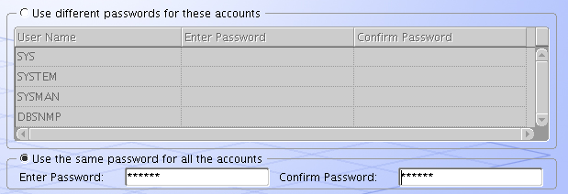
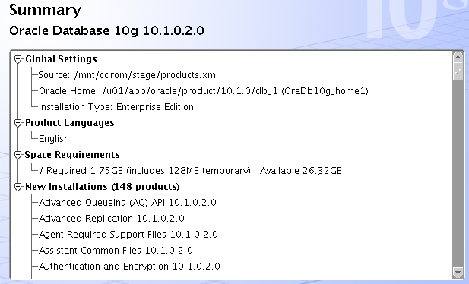
Jelszavak és Összefoglalás
Notes:
Oracle Database 10g: Administration Workshop I 2-<number>
Passwords and Summary
Database Schema Passwords: Provide passwords for the administrative users SYS, SYSTEM, SYSMAN, and DBSNMP. You can provide a password for each one separately or provide one password for all.
Summary: Here you see all the products and settings you selected for the installation. The next step is to initiate the installation. Check the summary then click Install to start the actual installation.

Slide 21
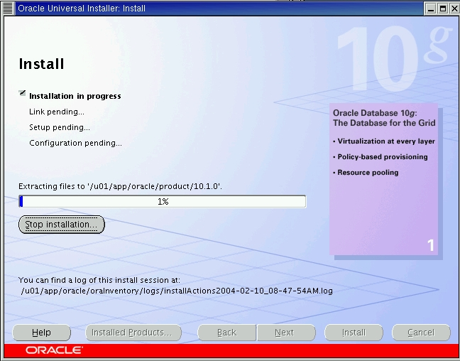
Telepítés
Notes:
Oracle Database 10g: Administration Workshop I 2-<number>
Installation
During the installation you can watch the progression of the installation.

Slide 22
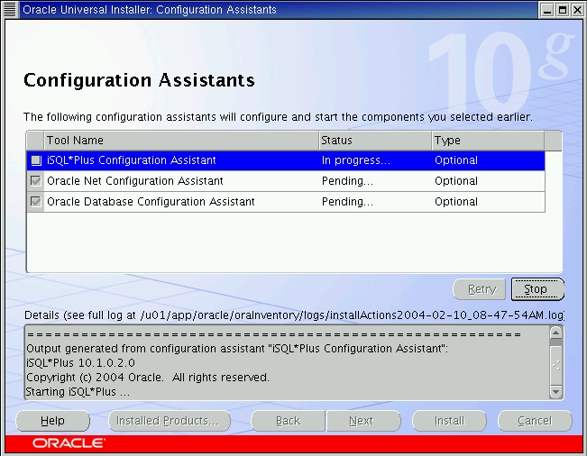
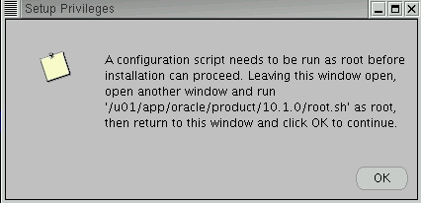
Konfigurációs segédek
Notes:
Oracle Database 10g: Administration Workshop I 2-<number>
Configuration Assistants
If you have selected to create a starter database with the install, the configuration assistants page will be displayed at the completion of the software install.
iSQLPlus Configuration Assistant: This configures the OC4J (Oracle Containers for Java) instance which is used by iSQLPlus and other tools to connect to the Oracle database.
Oracle Net Configuration Assistant: This configures basic network components during installation, including (these components are covered in detail in later lessons):
Listener names and protocol addresses
Naming methods the client will use to resolve connect identifiers to connect descriptors
Net service names in a tnsnames.ora file
Directory server usage
Oracle Database Configuration Assistant: This creates the starter database you selected. It uses the selection you made to create the database. In the next lesson you will learn more about Oracle Database Configuration Assistant. When this configuration assistant finishes you will have the opportunity to unlock accounts and change passwords.

Slide 23
Konfigurációs segédek folytatása
Teljes jegyzetlap
Notes:
Oracle Database 10g: Administration Workshop I 2-<number>
Configuration Assistants (continued)
When installing on a UNIX (or Linux) OS, or you did not chose to create a started database, you will be prompted to run one more script as root. The script is named root.sh. This script updates or creates a file that contains information about ORACLE_HOME locations and databases. In a Linux installation the file is named /etc/oratab.
With an installation on Microsoft Windows OS, there is no root.sh script because the information about ORACLE_HOME and databases is stored in the registry. The oratab file is the file where the user places references to all databases to be discovered by the Agent and controlled by Oracle Enterprise Manager.

Slide 24
Összefoglalás
Ebben a leckében ön elsajátíthatta a következőket:
  Rendszerkövetelmények azonosítása
  Az Optimális Rugalmas Architektúra használata
  Szoftvertelepítés az Oracle Univerzális Telepítővel
Notes:
Oracle Database 10g: Administration Workshop I 2-<number>

Slide 25
Gyakorlás 2:
Az Oracle szoftver telepítése
Ez a gyakorlófeladat lefedi az Oracle szofver telepítését.
Notes:
Oracle Database 10g: Administration Workshop I 2-<number>

Slide 26
Gyakorlás 2:
Az Oracle szoftver telepítése
Teljes jegyzetlap
Notes:
Oracle Database 10g: Administration Workshop I 2-<number>
Practice 2 – Install the Oracle Software
During the practices of this course you will assume the role of a new DBA who will be supporting a database which is used for a Human Resources application. You work for an IT manager; your coworker is an Oracle Certified Professional.
The OS accounts on your machine are:
The oracle user with a password of oracle.
The root user with a password of oracle.
The system administrator has set up the OS so that it is ready for the install and the install media is staged at /stage/Disk1. Install the software as the user oracle.
Set the global name to orcl.oracle.com and the SID to orcl
Use AL32UTF8 for the database character set
Create the database with sample schemas
Make sure oinstall is the selected group name on the Unix Group Name screen
Accept the defaults on the Specify File Locations page
Create a database using the General Purpose template
Use oracle as the password for all the administration accounts (sys, system, sysman and dbsnmp)
Unlock the HR schema

